Slide 1

HOW to Integrate Family Planning and Cervical Cancer Prevention Services
Dr. Heather White, PSI Global Advisor, Cervical Cancer/NCDs
November 4, 2019

Slide 2


PSI’S INTEGRATED SRH PROGRAMS

Slide 3
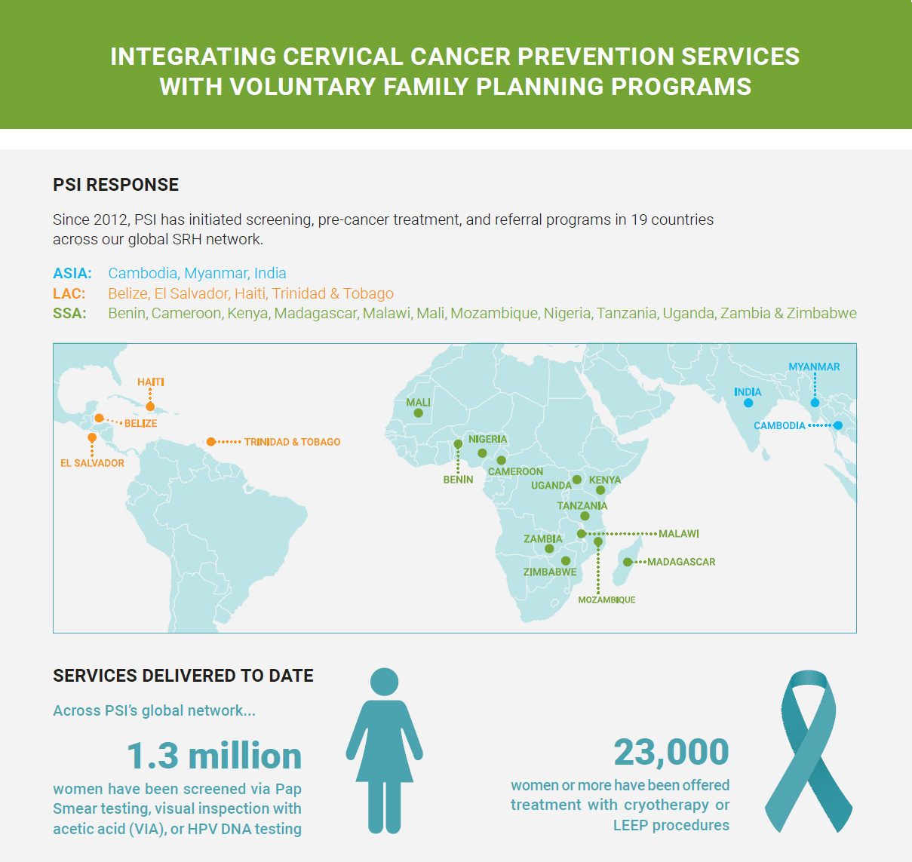
PSI offers FP services in over 30 countries, reaching millions of consumers and thousands of providers annually.
In 2018, PSI:
Reached 10.7 million users with modern contraception;
Provided almost 2.3 million HIV self-test kits
Provided 17.7 million CYPs
  7 million CYPs from LARCs;
  6 million CYPs from condoms;
  4 million CYPs from other STMs;
  and <1 million from PMs.

Slide 4
Integration Models
Static Facility-Based Services
Private sector delivery (e.g., social franchise model)
Public sector delivery
Community-Based Services
Community/CHW-based outreach
Dedicated mobile services

Slide 5

Preparation & Planning: Policy Context
Challenges, Opportunities and Champions
  Know national protocols and plans
  Understand role of domestic financing
  Role of technology, investments, business case
  Map health system: what services provided where
  Data capture at national level
  Find your champion(s)!

Slide 6
Preparation & Planning: Service Provision
SRH services: What services are currently provided and to whom? How will integration affect existing client load?
Analyze client flow for optimal use of physical space
Training needs: clinical, admin staff, QA teams, lab, community promoters, others?
Didactic and practical training, ideally with national trainers
Identify technical working groups, professional bodies, national trainers to share and learn from

Slide 7

Informing Demand for Integrated Services
Review of existing SRH materials
Seek regular client and provider feedback
What do people need to know?
Which channels?
Message development across SRH spectrum and life cycle
Consistently work with providers on messaging

Slide 8

III
SERVICE DELIVERY
Once launched, routinely monitor client volumes, uptake and
loss to follow up.
Review service volumes: Ensure vFP/method mix, time, financial &
opportunity costs, need for additional care beyond primary level
Talk to Consumers/Providers Regularly:
Client exit interviews
FGDs/IDIs with all frontline health workers and clients
Mystery clients
Track messaging, communications channels
Common integration barriers: costs, time, distance to travel, fear
of additional follow up

Slide 9
Monitoring & Evaluation
Routine program data/reporting
Quality/Assurance and SSV data/outcomes
Client satisfaction
Client level data best, but not always easy to get

Slide 10
THANK YOU!

Slide 11





Connect with us.
Like us
Facebook.com/PSIHealthyLives
Visit us
psi.org
i
See our impact
Psiimpact.com
Follow us
@PSIImpact
Follow us
Linkedin.com/company/
Population-Services International
Follow us
@PSIImpact

